Slide 1

The Achievement Benefits of Standardized Testing^{(c)}
Richard P. Phelps
(c) 2003, by Richard P. Phelps

Slide 2

The achievement benefits of standardized testing: outline
Main benefits
Why tests?
Why high-stakes tests?
The lost world of testing achievement benefit research
The lost art of literature searching
Why a keyword search is inadequate to this (and most) topics
Methodologies used in studies of testing achievement benefits
Check back later for updates

Slide 3

Main types of benefits associated with standardized testing
(1) Information:
information is used for diagnosis (of students, teachers, schools)
information is used for alignment (of standards, instruction, across schools or districts,
“what is tested is what is taught” focuses student and teacher efforts on what counts

Slide 4

Main types of benefits associated with standardized testing
(2) Motivation:
students, teachers, schools are motivated to demonstrate their competence (to themselves and to others)
they are motivated to know more, now that they know where to concentrate their efforts
they may be motivated by positive or negative consequences tied to their performance (e.g., promotion or retention, pay raise)

Slide 5


Why tests?
Students tend to study more, and learn more, when it is:
not known in advance exactly what will be tested
(e.g.) Experiment comparing gains of students with “take-home tests” to those with “in class tests” -- the latter learned substantially more.
when there is reinforcement of material already studied
Mastery learning experiments of 1960s—1980s:
Students learn more when asked to recall what they have learned.
Up to a point, the more students are made to actively process information, and describe it to others, the better they learn.

Slide 6

Why high-stakes tests?
Most of us respond to both intrinsic and extrinsic motivators and the proportion varies from individual to individual. High-stakes tests provide both forms of inducement.
The “Lake Wobegon Effect” occurred with “no stakes,” “internal” tests. Too many local educators manipulated

Slide 7

The lost world of testing achievement benefit research
Repetitive, insistent claims by testing opponents (e.g., CRESST, FairTest)
Even some folks who could not be labeled as testing opponents (e.g., Bill Mehrens, Greg Cizek) claim no evidence
Even the Bush Administration's advisors on education research have claimed no evidence

Slide 8

The lost art of literature searching
A computer search is a “black box” providing a false sense of security
Computer keyword searches have made researchers lazy and myopic.
Computer searches not adequate for finding most of the literature on a topic, much less a representative sample of it.
Relying on a computer search alone introduces bias to a study.

Slide 9

Why keyword searches are inadequate to the study of testing benefits
Most data bases only attach several
keywords to each document
Keywords tend to be academic discipline specific
Most research studies uncovering testing benefits were focused on some other topic, and the keywords attached reflect that other focus.

Slide 10

More reasons why keyword searches are inadequate to the study of testing benefits
Many, if not most, studies finding testing benefits are not stored in any data bases – they are government program evaluations, proprietary studies conducted by testing firms, or research conducted by testing practitioners, who have little incentive to publish in the academic literature.

Slide 11

Still more reasons why keyword searches are inadequate to the study of testing benefits
Some studies uncovering testing benefits also uncover testing drawbacks, and the overall result given in the summary focuses on the negative.
Some studies conducted by education professors simply disregard the positive evidence in their summaries.
Some studies are fraudulent (e.g., data were doctored)

Slide 12

Methodologies used in testing achievement benefit studies
Conceptual or analytical models
Controlled experiments
Quasi-experiments
Multivariate analysis (manova, multiple regression)
Interrupted time series with shadow measure
Pre-post studies
Program evaluations and surveys
Case studies
Benefit-cost studies

Slide 13
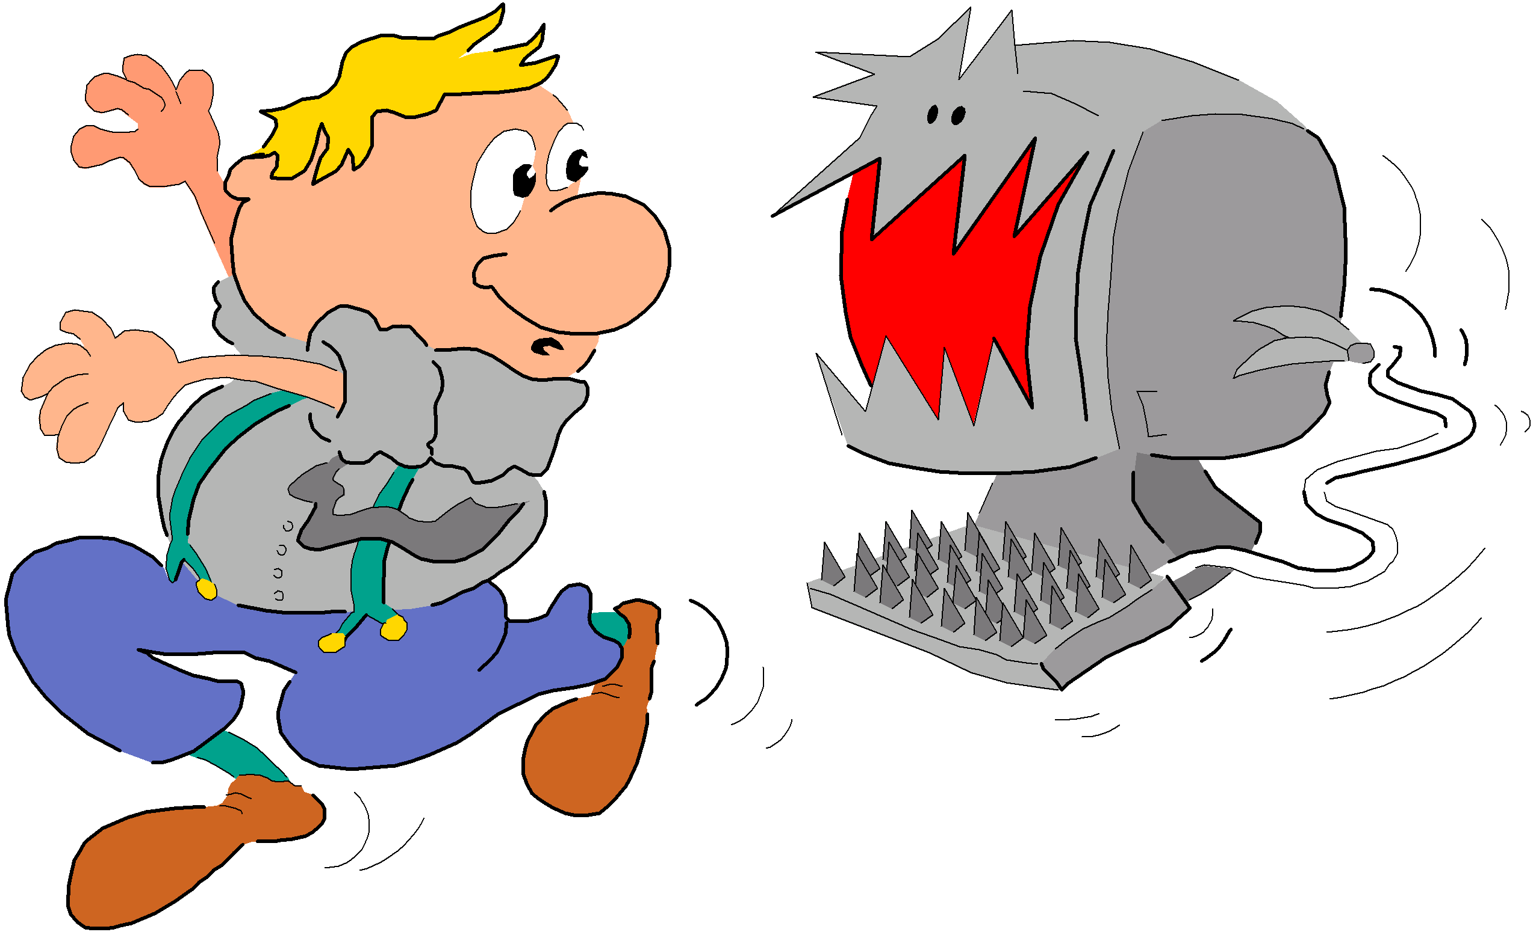
For more, see:
Phelps, R.P., Ed. (2005). Defending standardized testing, Mahwah, N.J.: Lawrence Erlbaum. [ISBN: cloth: 0805849114, paper: 0805849122]

